Slide 1
Adaptive and Background-Aware Vision Transformer for Real-Time UAV Tracking
ICCV 2023 Submission # 12437
${\text{Shuiwang} \text{Li}}^{ 1}$, ${\text{X}\text{iangyang} \text{Y}\text{ang}}^{ 1}$, ${\text{Dan} \text{Zeng}}^{ 2,∗}$, and ${\text{Xucheng} \text{Wang}}^{ 1}$
$^{1}$College of Information Science and Engineering , Guilin University of Technology, China $^{2}$Research Institute of Trustworthy Autonomous Systems, Southern University of Science and Technology, China

Slide 2
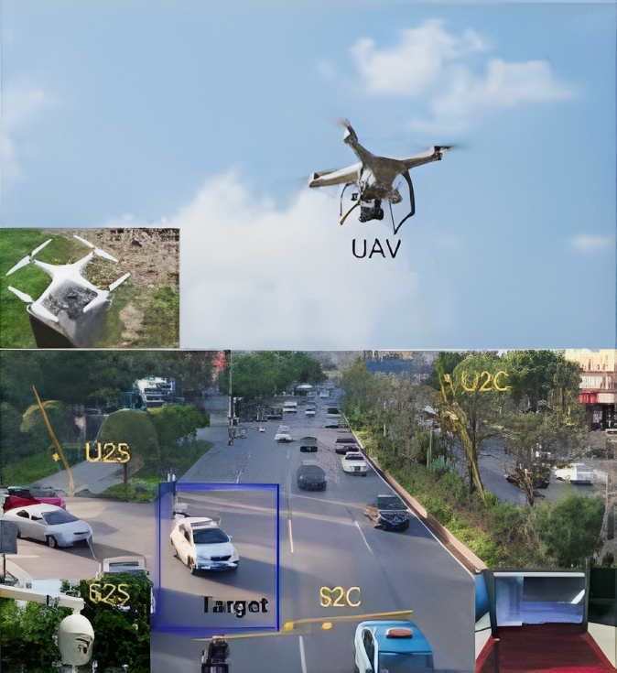
Background
UAV Tracking
Various of applications:
Transportation and Traffic Management,
Search and Rescue,
Security and Surveillance
Delivery and Logistics
...

Slide 3
Challenges
Communication Range: Maintaining reliable communication links, especially in remote or high-altitude areas.
Battery Life: Extending the endurance of UAVs to cover longer distances or conduct extended missions.
Weather Conditions: Adapting to adverse weather conditions, such as high winds, rain, or fog, during flight.
...

Slide 4
Motivations
The motivation for this study arises from the need to enhance real-time unmanned aerial vehicle (UAV) tracking using efficient Vision Transformers (ViTs). Specifically, we aim to improve the feature learning and template-search coupling processes using efficient ViTs to make them suitable for real-time UAV tracking.

Slide 5
Our Contributions
We make the first attempt to explore using efficient ViTs, particularly in a unified framework, for real-time UAV tracking.
We propose an efficient ViT, Aba-ViT, which incorporates adaptive and background-aware token computation. This allows Aba-ViT to learn halting probabilities that are a priori higher for background tokens than target ones.
Our Aba-ViTrack sets a new state-of-the-art record on six challenging benchmarks, namely UAV123@10fps, UAVDT, VisDrone2018, UAV123 , DTB70 and UAVTrack112_L.

Slide 6
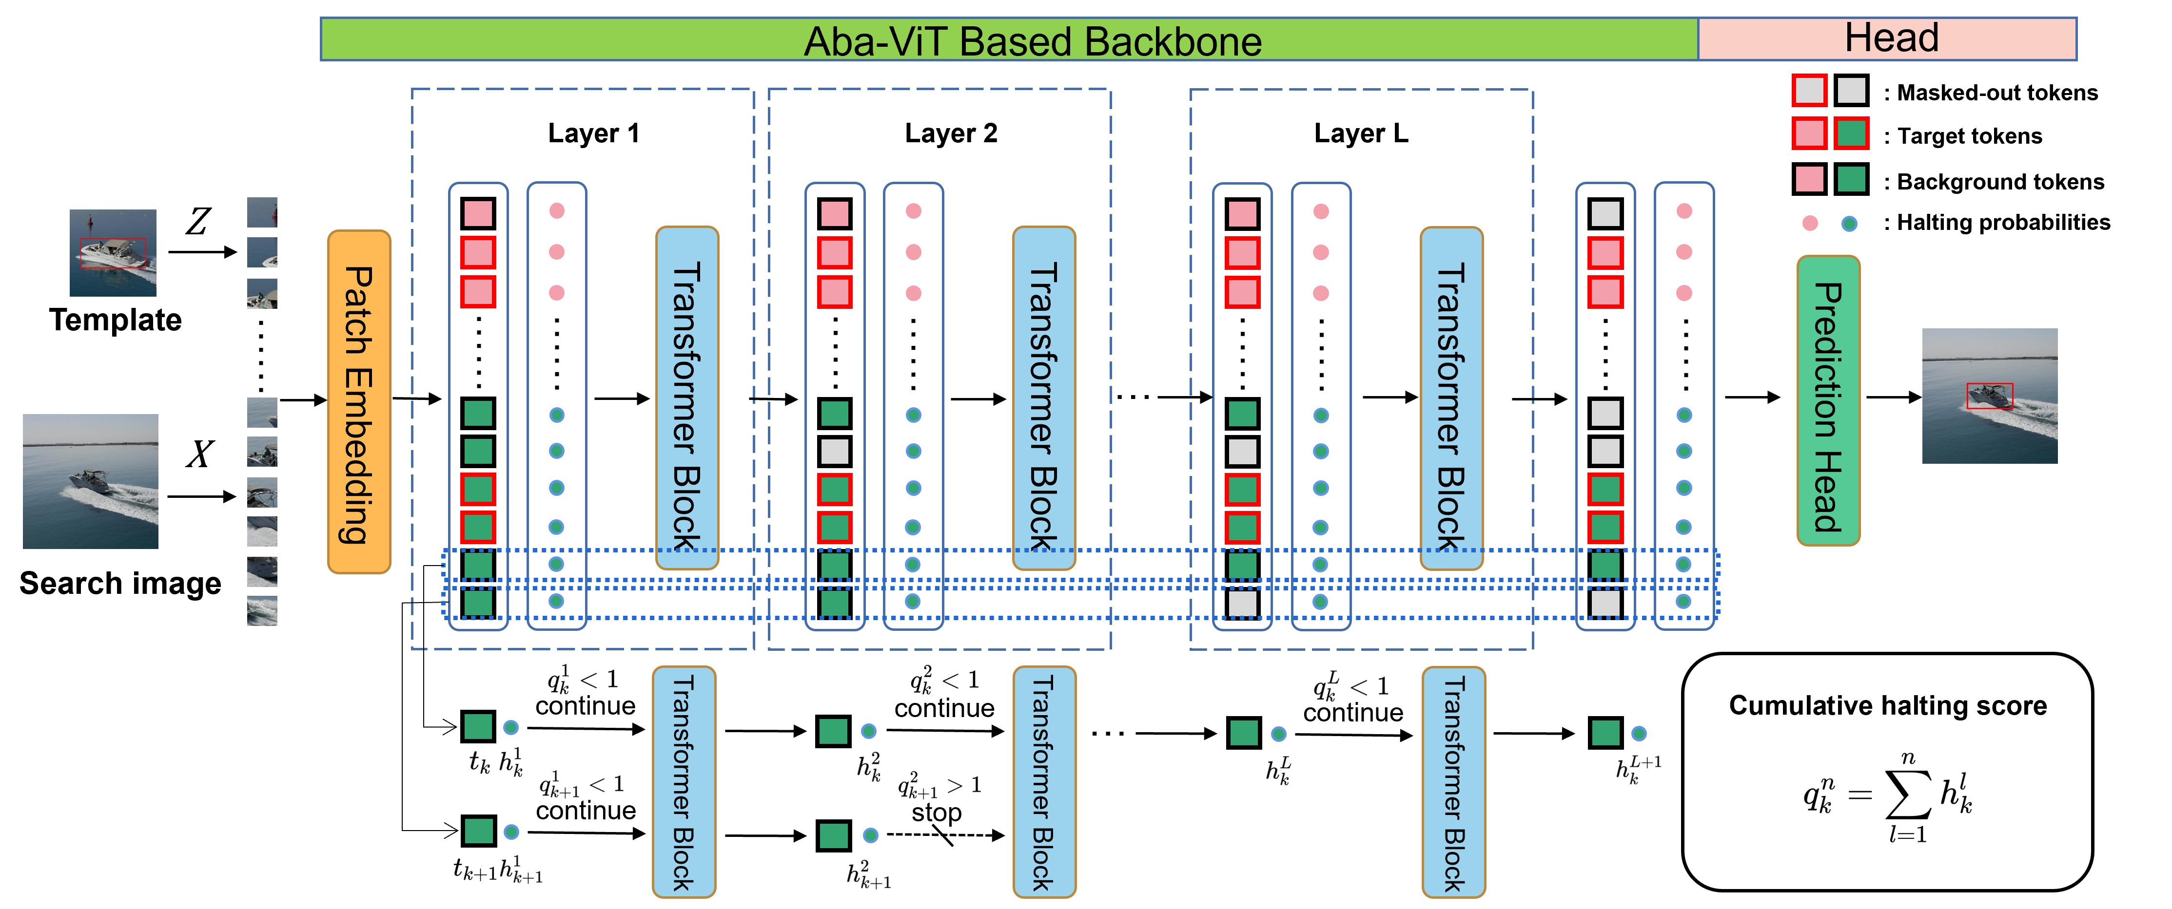
Aba-ViTrack framework

Slide 7
Experiments
Datasets: UAV123, UAVTrack112_L, DTB70, UAV123@10fps, VisDrone2018, and UAVDT.
Trackers for comparison:
light-weight trackers
deep trackers

Slide 8
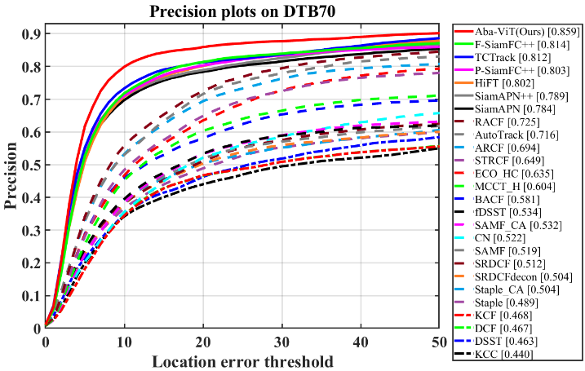
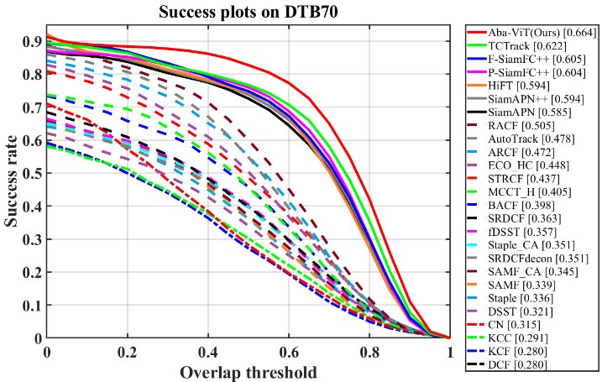
Comparison with Light-Weight Trackers
Overall performance of hand-crafted based trackers on DTB70

Slide 9
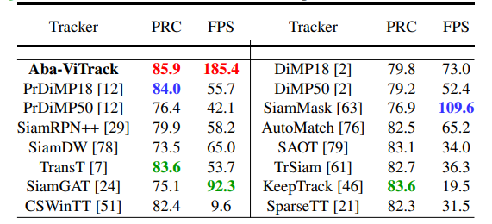
Comparison with Deep Trackers
Precision and speed (FPS) comparison between
Aba-ViTrack and deep-based trackers on DTB70

Slide 10
Evaluation of efficient ViT-based Trackers
Four lightweight ViTs, i.e. ViT-tiny, DeiT-tiny, A-ViT, and Aba-ViT, are integrated into the proposed tracking framework, denoted by ViT-tiny*, DeiT-tiny*, A-ViT*, and Aba-ViT*, respectively. Note that the precision and AUC are shown in form of (PRC, AUC).

Slide 11
Ablation Study
Ablation study of weighting the ponder loss $L_{ponder}^{∗}$on DTB70 with $α_{p}$ ranging from ${0.5×10}^{−4}$ to ${1.5×10}^{−4}$ .
Ablation study of weighting the background tokens on DTB70 with $ω_{b}$ ranging from 1.0 to 3.0.

Slide 12
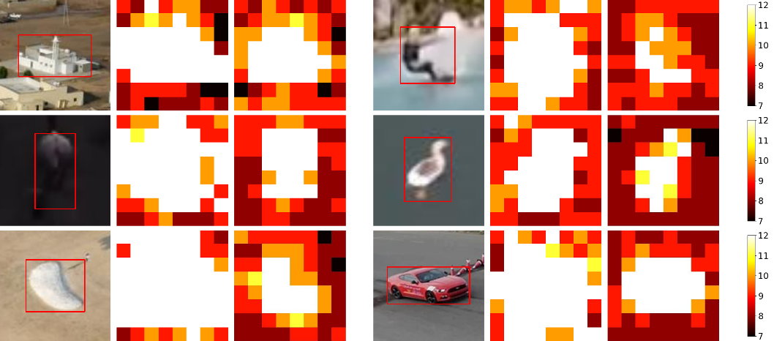
Qualitative results
Visualizes the token’s depth that is adaptively controlled during inference with A-ViT* and our Aba-ViTrack

Slide 13
Real-World Test
The real data visualization recorded on the UAV platform is visualized
Platform : NVIDIA Jetson TX2 4GB
Utilization rates : 27.7% (GPU) and 18.9%(CPU)
Average speed : 35.6 FPS

Slide 14
Conclusion
We make the first attempt to explore using efficient ViTs in a unified template-search coupling framework for real-time UAV tracking.
We proposed a generalized ponder loss to leverage prior information about background and target for background-ware and more effective adaptive halting for UAV tracking.
The experimental results demonstrate the effectiveness of our proposed method.

